Slide 2
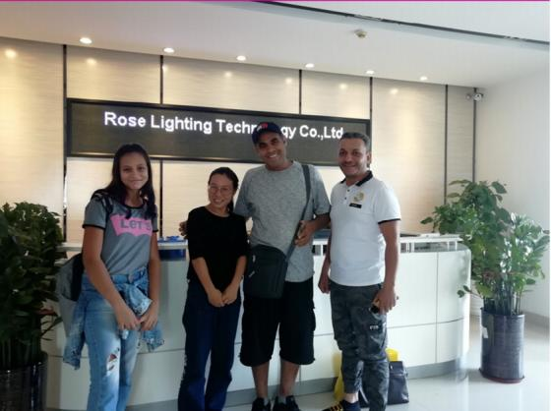
Company profile
Shenzhen Rose Lighting Technology Co.,Ltd devotes to the high quality LED landscape decoration lighting product production, research and development of new
new led lighting product . with our knowledget of led products production and suppling Dating from 2012 , we believe our product meet
your expenected quality requirmentss &latestart of technology. We take pride in our reputation as one of the Chinese premium led lighting products
manufacturer and supplier.
Rose Lighting uphold the business philosophy of continuous innovation, long-term research and development of new products to cater to the
market demand, by the new and old customers.
Company tenet
Quality first, reputation is important, management oriented sincere service.win ₋win together .

Slide 3
Advantages
-Focused on manufacturing LED strip lighting overa decade.
-Competitive price and project solution service
-More than 100 project cases each year - vast knowledget to handling lighting case
-All Types of LED strip are available.
-Skilled support team and engineering service
-Visable all kinds of project case show and Exhibition board in our showroom OEM/ODM offered
-Realiable and safe payment methods.
-Same Quality Management as OSRAM and Thorn.ect
Website
https://www. rose-lighting.com
https://www.rose-lighting.cn
https://www.rose -light.com
https://roselighting.en.alibaba . com
https://www.youtube. com/c/roselighting
Product Contents
● Pixel LED strip TTL/SPI
● DMX512 LED Strip
● RGB LED strip&RGBW &RGB+CCT LED strip
● Monochrome ^{&CCT} LED strip
● COB LED strip
● Neon LED strip &neon flex led wall washer
● Reflection LED Module Light
● Digital Fairy Lights

Slide 5
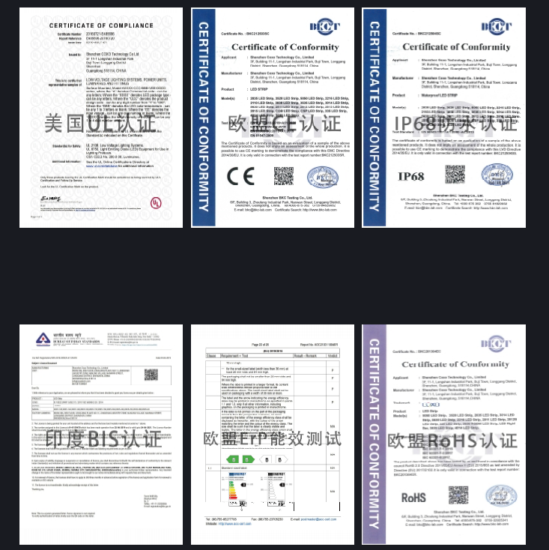
Certificate
Shenzhen Rose Lighting Technology Co., Ltd. was established in 2012 and is a global enterprise engaged
in the research and development, production, and
manufacturing of LED strips. We have been focusing
on the LED strip industry for over 12 years and have
a complete and professional system for the research
and development, manufacturing, sales, and service
of LED strip products; All products of the company
comply with international quality standards and have
passed certifications such as UL, CE, RoHS, ERP, and
BIS. With professional services and high-quality
products, we have won the support and trust of
global customers.

Slide 6
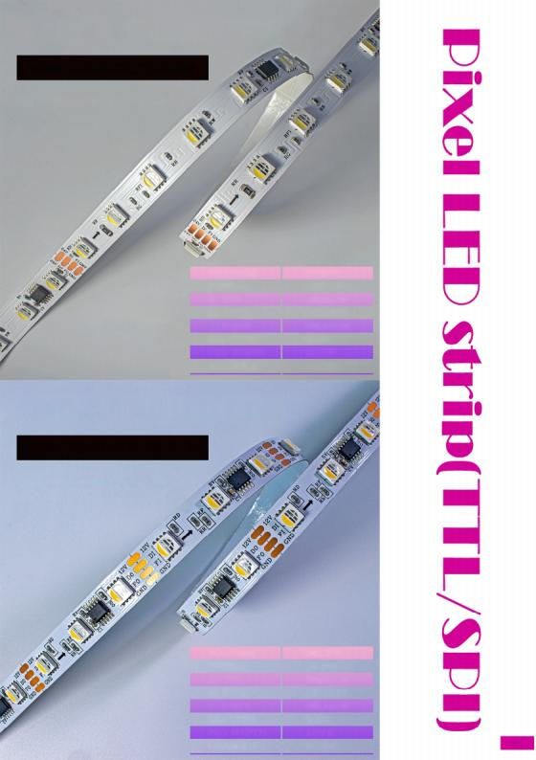
SPI DIGITAL LED STRIP
RGBW FOUR COLOR STRIP
TM 1834 - 60LEDS /M
VO LTAG E
POWER
IC QTY
I C TYPE
LE D QTY
L E D TYPE
PC B WIDTH
CH AN N EL
DC 24V
1 8W /M
10 pi x/M
TM 1834
6 0LED /M
5050
10 M M
RG BW
SPI DIGITAL LED STRIP
RGBW FOUR COLOR STRIP
TM 1834 - 60LEDS /M
VO LTAGE
POWER
IC QTY
I C TYPE
LED QTY
LE D TYPE
PC B WIDTH
CH AN N EL
DC 12V
1 0 . 8W /M
20 pix/M
TM 1834
6 0LED /M
5050
10 M M
RG BW
01

Slide 7
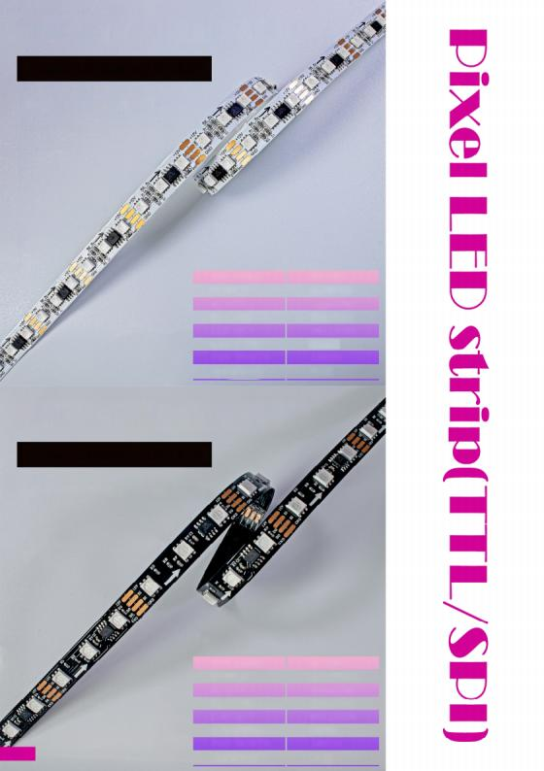
SPI DIGITAL LED STRIP
D UA L S IG N A L ST R IP
TM 1934 - 9 6LEDS/M
VOLTAG E | DC 1 2V
POWER | 9 . 6W/M
IC QTY | 32 pix /M
I C TYPE | TM 1934
LED QTY | 9 6LE D /M
LED TYP E | 3535
PCB WIDTH | 1 0M M
CHAN N EL | RGB
SPI DIGITAL LED STRIP
D U AL SIG N A L S T RIP
TM 1934 - 60LEDS /M
Best seller
VOLTAG E
POWER
IC QTY
I C TYPE
LED QTY
LED TY P E
PCB WIDTH
CHAN N EL
D C 1 2V
1 1 . 2W/M
20 pix /M
TM 1934
60LED/M
5050
1 0MM
RGB
02

Slide 11
SPI DIGITAL LED STRIP
S IN G L E SI G N AL ST RI P
SK 6 8 12 - 60LEDS /M
VO LTAG E | DC 5V
POWE R | 9 . 5W /M
IC QTY | 60 pi x/M
I C TYPE | SK 6812
LE D QTY | 60LED/M
LE D TYPE | 50 5 0
PC B WIDTH | 10 M M
CH AN N EL | G RB
SPI DIGITAL LED STRIP
S IN G L E SIG N AL ST RI P
SK 6 8 12 - 1 44LEDS /M
VO LTAGE
POWE R
IC QTY
I C TYPE
LE D QTY
LE D TYP E
PC B WIDTH
CH AN N EL
DC 5V
1 1 . 2W/M
144 pi x/M
SK 6812
144LED /M
5050
1 2 M M
G R B
06

Slide 12
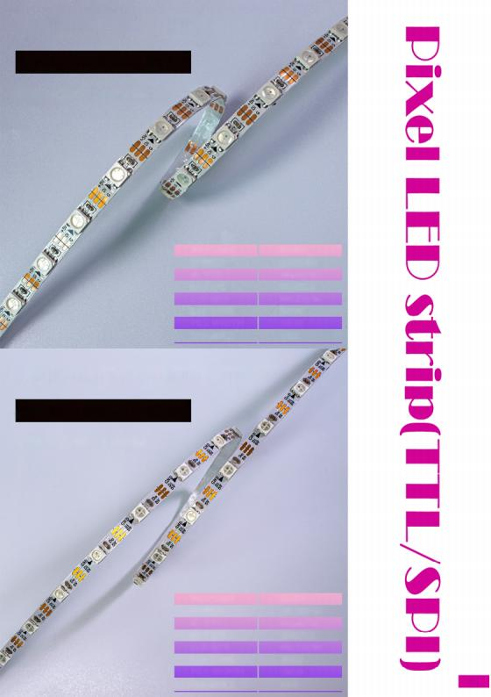
SPI DIGITAL LED STRIP
S IN G L E SIG N AL STRI P
SK 6 812 - 60LEDS/M
VO LTAG E
POWER
IC QTY
I C TYPE
LED QTY
LED TYPE
PC B WIDT H
CHANNEL
DC 5V
9 .5W/M
60 pix/M
SK 6812
6 0 LED /M
5 0 50
5MM
GRB
SPI DIGITAL LED STRIP
S I N G LE SIG N AL S T RI P
SK 68 1 2 - 6 0LEDS/M
VO LTAG E
POWER
IC QTY
I C TYPE
LED QTY
LED TYPE
PC B W IDTH
DC 5V
1 0 . 2W/M
60 pix/M
SK 6812
60LED/M
3535
4M M
CHAN N EL
GRB
07

Slide 13
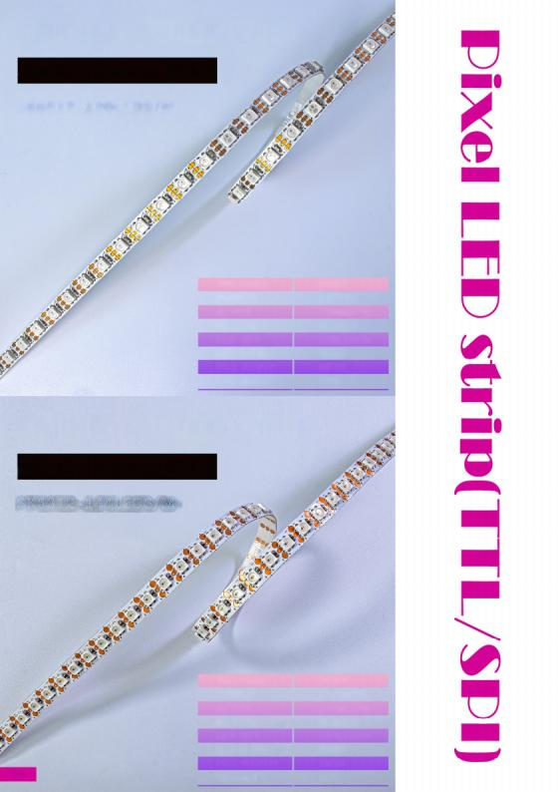
SPI DIGITAL LED STRIP
S IN G LE SIG N AL ST RI P
SK 6 8 1 2 - 1 2 0LEDS/M
VO LTAG E | DC 5V
POWER | 1 6W /M
IC QTY | 120 pi x/M
I C TYPE | SK 6812
LED QTY | 120LED /M
LED TYPE | 353 5
PC B WIDT H | 5M M
CHAN N EL | GRB
SPI DIGITAL LED STRIP
S I N G LE SI G N AL S T RI P
SK 6 8 12 - 1 44LEDS /M
VO LTAG E
POWER
IC QTY
I C TYPE
LE D QTY
LE D TYPE
PC B WIDTH
CH AN N EL
DC 5V
1 7 . 5W/M
144 pix/M
SK 6812
144LED /M
3535
7M M
G R B
08

Slide 14
SPI DIGITAL LED STRIP
S ₋ SI N GLE SI GNAL STRIP
SK 6812 - 60LEDS /M
VOLTAG E
POWER
IC QTY
I C TYPE
LED QTY
LED TYP E
PCB WIDTH
CHAN N EL
DC 5V
8. 2W/M
60 pix /M
SK 6812
60LE D /M
5050
5M M
GRB
SPI DIGITAL LED STRIP
RGB SINGLE SIGNAL STRIP
WS 2 8 11 - 6 0LEDS /M
VO LTAG E
POWER
IC QTY
I C TYPE
LED QTY
LED TYP E
PCB WIDTH
CHAN N EL
DC 12V
12W/M
20 pix /M
WS 28 11
60LE D /M
5050
1 5M M
RG B
09

Slide 15
SPI DIGITAL LED STRIP
WHITE SINGLE SIGNAL STRIP
TM 1903 - 12 0LEDS/M
VOLTAG E | DC 1 2V
POWER | 10 . 2W /M
IC QTY | 8pix/M
I C TYPE | TM 1903
LED QTY | 12 0 LED /M
LED TY P E | 2835
PCB WIDTH CHAN N EL | 1 0MM
SPI DIGITAL LED STRIP
RGBCW FIVE COLOR STRIP
TM 1 936 - 60LEDS /M
VO LTAG E | DC 24V
POWER | 24W/M
IC QTY | 10 pix /M
I C TYPE | TM 1936
LED QTY | 60LED /M
LED TY P E | 5050
PCB WIDTH | 1 0M M
CHAN N EL | RG B CW

Slide 16
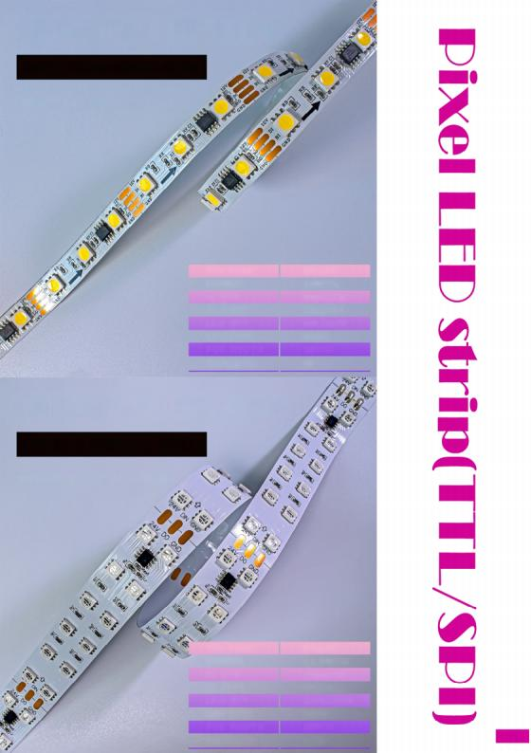
SPI DIGITAL LED STRIP
WHITE DUAL SIGNAL STRIP
TM 1934 - 60LEDS /M
VO LTAG E
POWER
IC QTY
I C TYPE
LED QTY
LED TYPE
PCB WIDTH
CHA N N E L
DC 12V
1 0W /M
2 0 pix/M
TM 1934
6 0LED /M
50 5 0
1 0 M M
W
SPI DIGITAL LED STRIP
S I N G L E S IG N A L S T R I P
WS 2 8 11 - 120LEDS /M
VOLTAG E
POWE R
IC QTY
I C TYPE
LED QTY
LED TYPE
PCB WIDTH
C HA N N E L
DC 2 4V
1 1 . 8W/M
1 0 pi x/M
WS 2811
120LED/M
50 5 0
2 0 MM
RG B
11

Slide 17
SPI DIGITAL LED STRIP
WHITE COLOR DIGITAL STRIP
TM 1934 - 12 0LEDS /M
VOLTAG E | DC 24V
POWER | 12W/M
IC QTY | 20 pix /M
I C TYPE | TM 1934
LED QTY | 12 0LED /M
LED TY P E | 2835
PC B WIDTH | 1 0M M
CHAN N EL | W
SPI DIGITAL LED STRIP
DUAL SIGNAL LED WASHER
TM 1 934 - 48LEDS /M
VO LTAG E | DC 24V
POWER | 10W/M
IC QTY | 8pix/M
I C TYPE | TM 1934
LED QTY | 48LED /M
LED TYP E | 3030
PCB WIDTH | 1 5M M
CHAN N EL | RG B

Slide 18
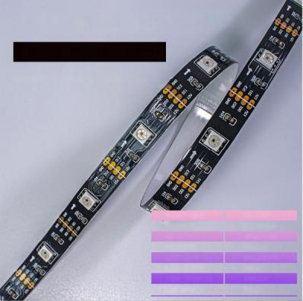
SPI DIGITAL LED STRIP
D U A L S IG N A L S TRI P
SK 68 13 - 30LEDS /M
VOLTAG E
POWER
IC QTY
I C TYPE
LED QTY
LED TYP E
PC B WIDTH
CHAN N EL
DC 1 2V
4. 3W/M
30 pix/M
S 6813
30 LED /M
5050
1 0M M
RG B
SPI DIGITAL LED STRIP
D U A L SIG N A L S TRIP
SK 68 13 - 60LEDS /M
VOLTAG E
POWER
IC QTY
I C TYPE
LED QTY
LED TY P E
PCB WIDTH
DC 1 2V
8.3W/M
60 pix /M
S 6813
60LE D /M
5 0 5 0
1 0M M
CHAN N EL
RG B
13

Slide 22
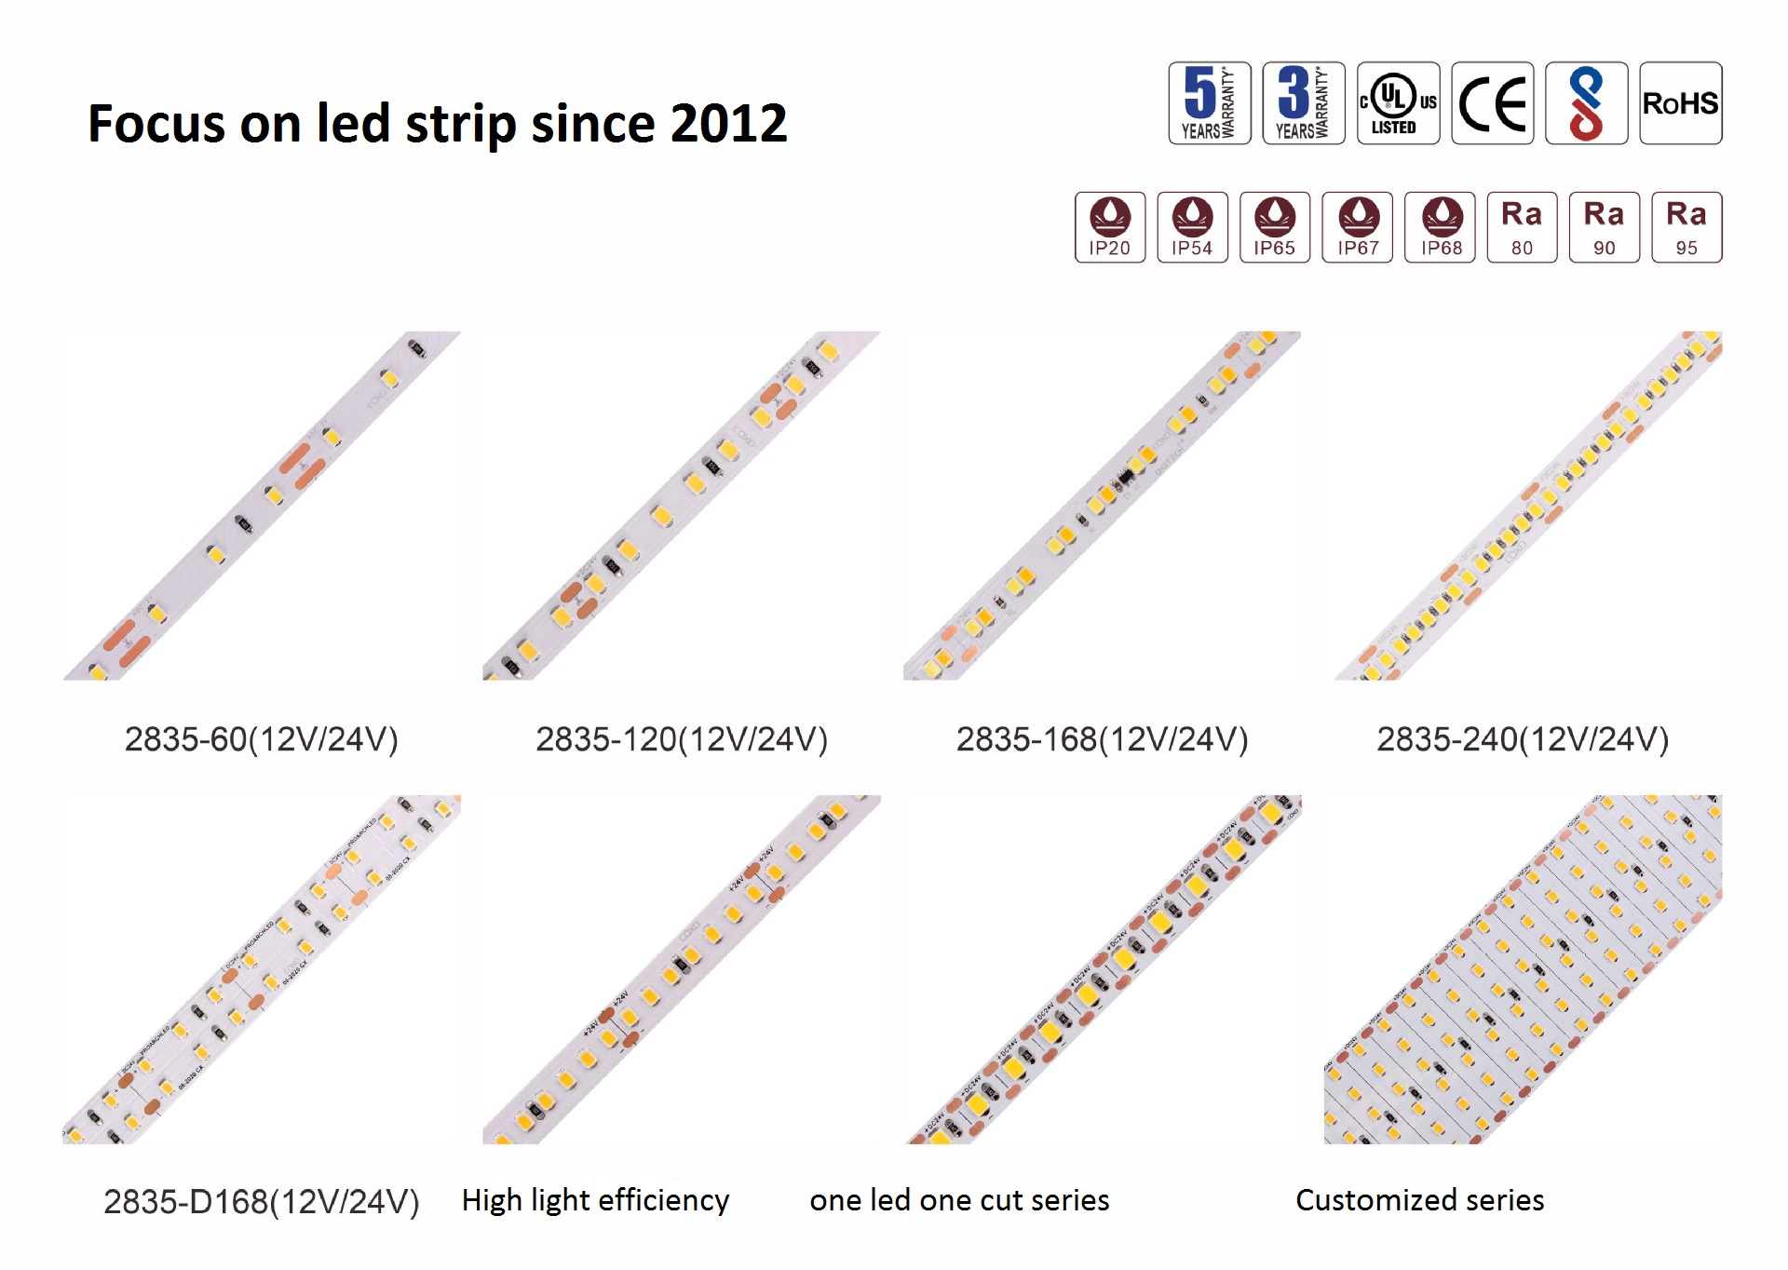
IP Rate

Slide 23
Cob led strip

Slide 25
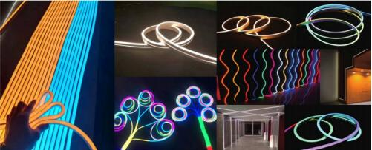
Advantages
1. There are flexible , can be curved to form any sytle or shape.
2. Easily can replace led tube, there are flexible which makes them ideal to use on curved surfaces or environment.
3. Can achieve multi beam angles which are 120°, 180°, 270°, 360°
Good choice to replace led tube, led linear .
4. The length, power, brightness and CCT can be customized to suit your needs or preferences.
5. Easy to install and transport without fear of any damage.
6. Applied well n all kinds of High₋end venue and outdoor use (Ip rate : 65-67); 7 .take the advantage of unique optical technique and special housing design , it increases the intensity and uniformity of light greatly , anti UV 8AllTypes belong to low voltage led strip ,voltage varies from DC5V ₋ DC24v , can be cut at 1led , 3led , 6leds to make a individual part;
9 Enough Mounting accessories and end caps included for project use;
10.Packing : 5m/roll,Static bag seal packing(locking static bag+moisture₋ proof Desiccant ,easy to transport and safety to carry .
11 . Warranty: 2years warranty
19

Slide 26
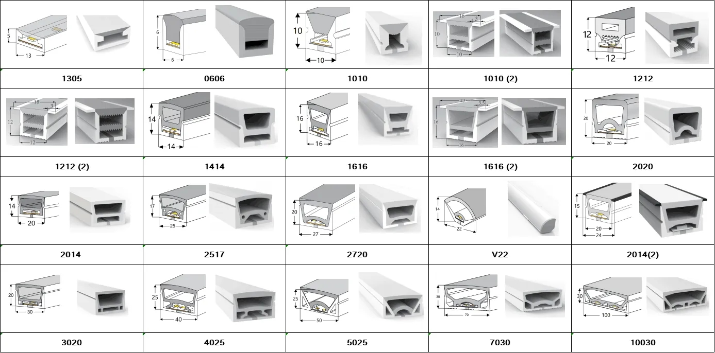
Neon tube size

Slide 27
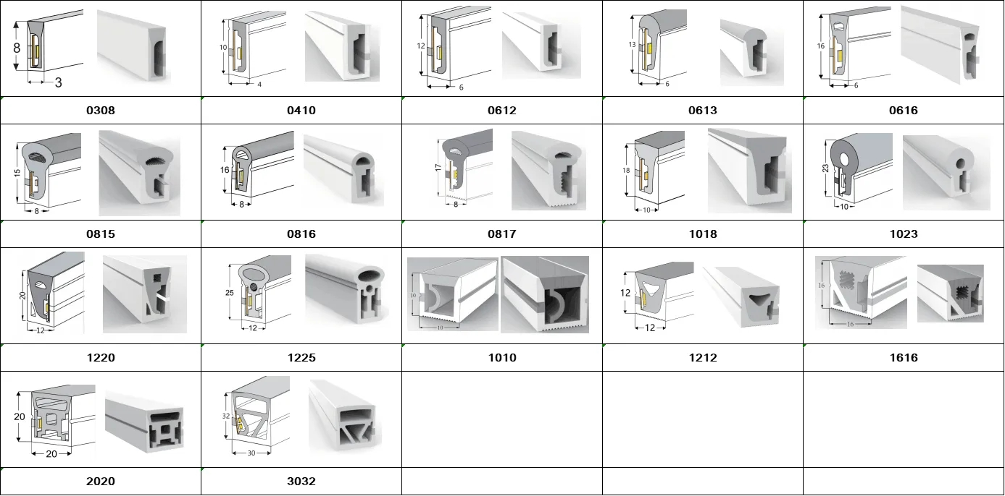

Slide 29
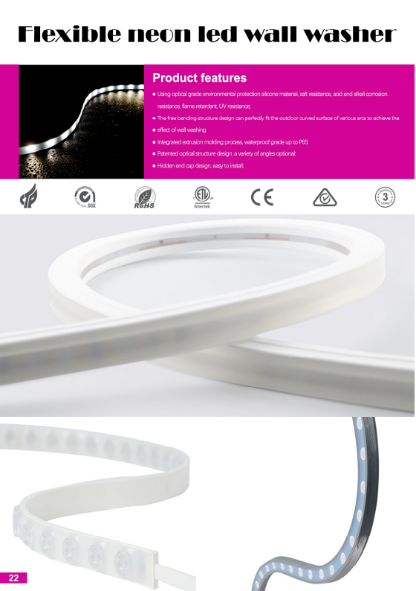

Slide 30
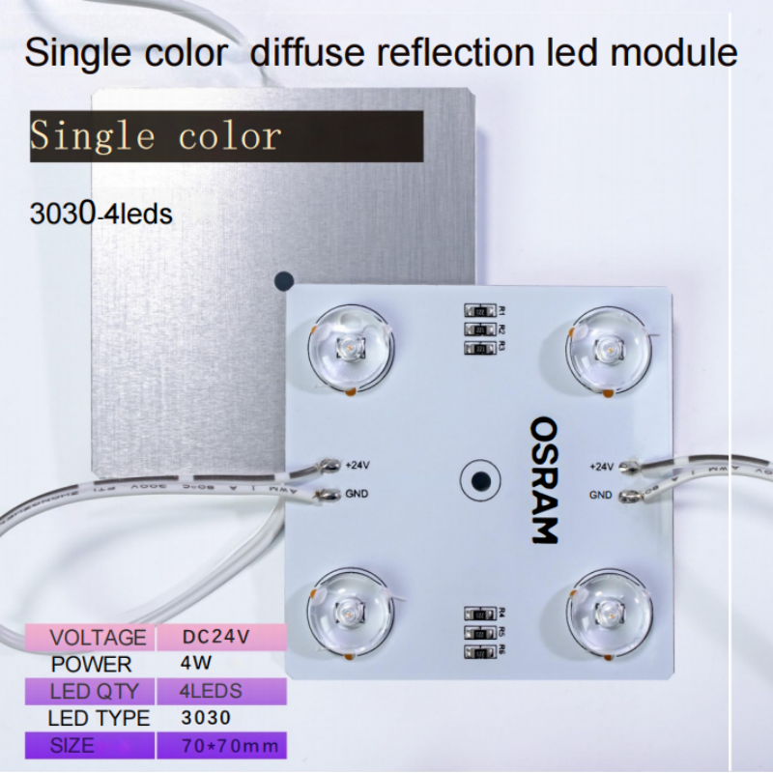
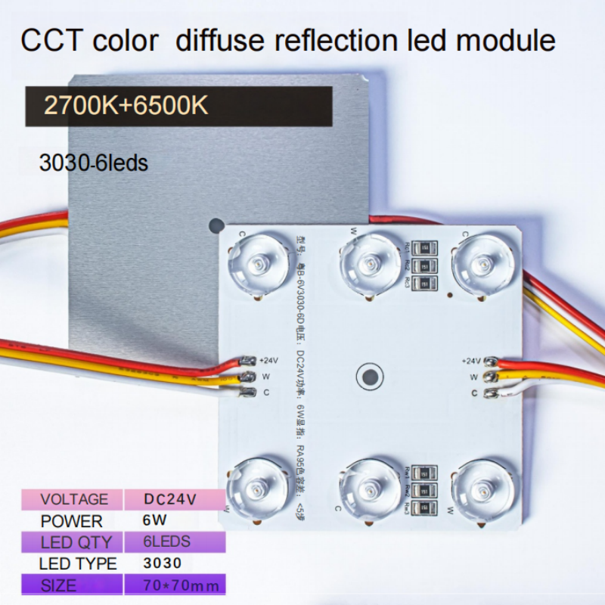
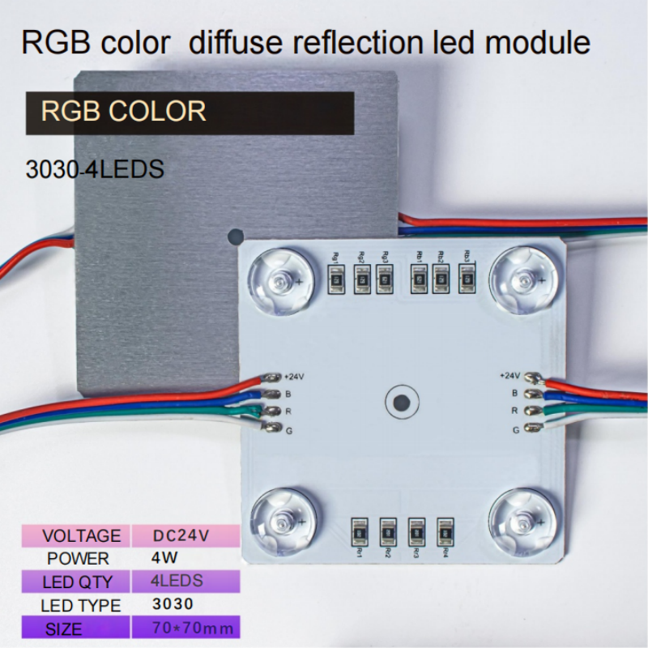
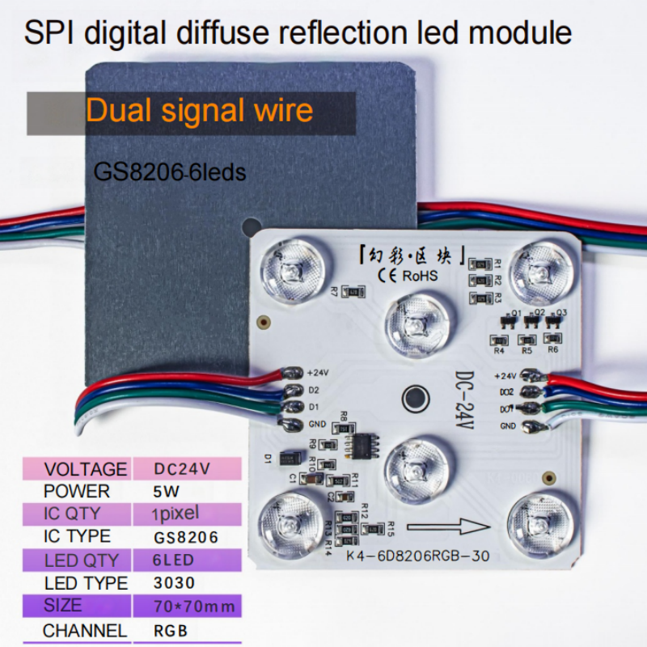
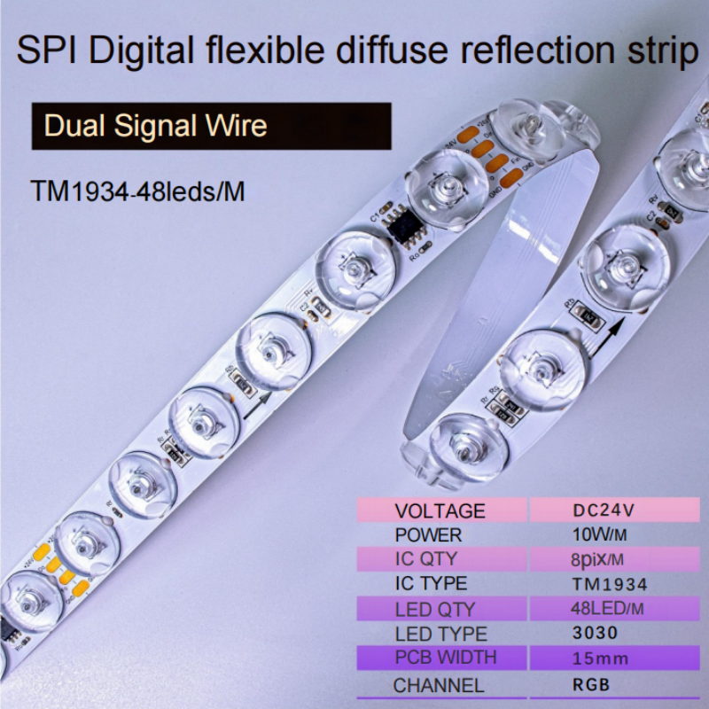
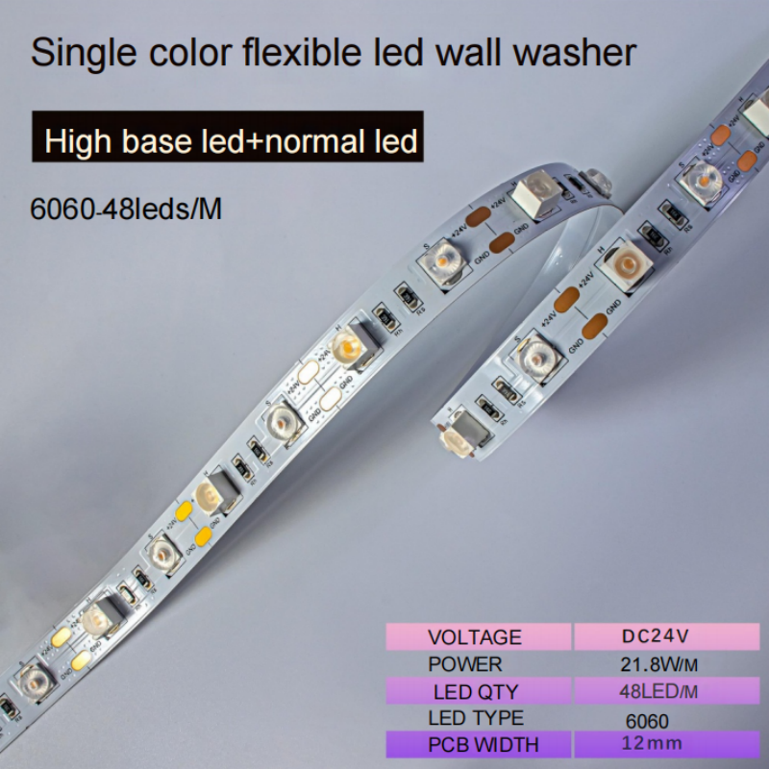
Reflection LED Module Light

Slide 31
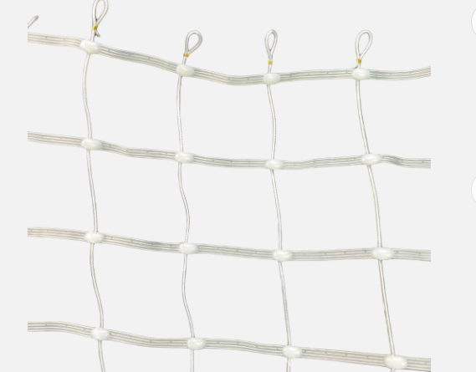
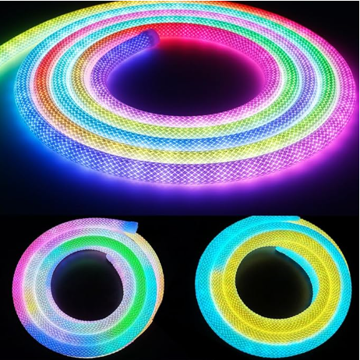
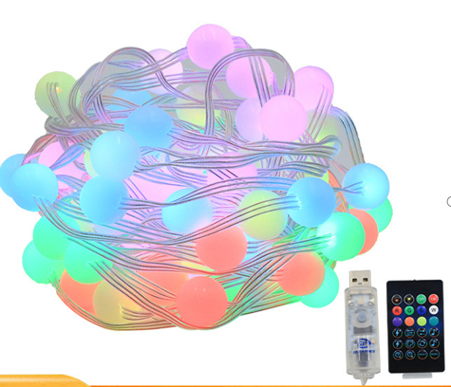
Digital Fairy Lights and other new product

Slide 32
Digital Fairy Lights and other new product

Slide 33
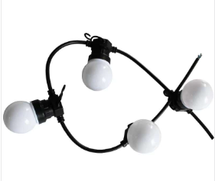
Digital Fairy Lights and other new product

Slide 34
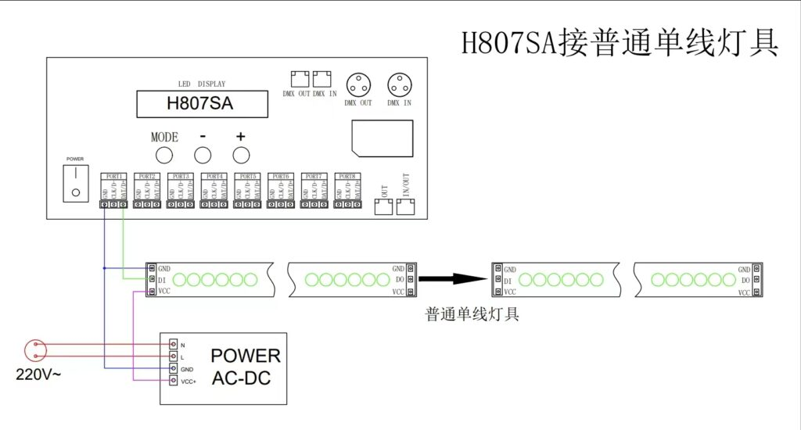
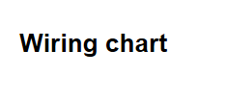

Slide 35
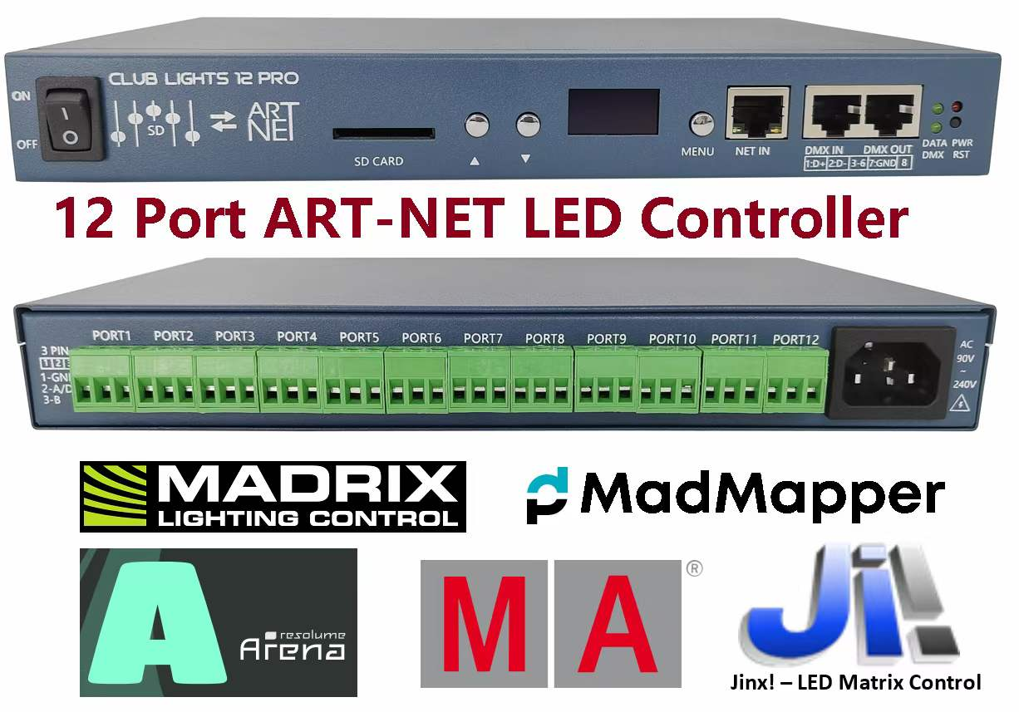
Features of the artnet led controller GC6612
(1). 12 output ports, controls maximum 12288pixels, each port controls maximum 1024 pixels.
(2).Offline SD card, single model controller, with sd card to play the programs inside. with 4GB capacity
(3).GC6612 can be connected to DMX console, you can replace file, and adjust speed and brightness by DMX console.
(4)FPGA, as the core processor, truly realizes high-load, high-speed, and high-gray control
(5)suport drawing lighting diagram wireless ( inkbook wifi inside the led controller)
(6)LED display, display parameters and address codes, and set address codes and parameters in combination with buttons
(7)Supports various types of lighting driver ICs: DMX512, UCS series, TM series, LX series, GW series, TLS series, MY series, etc.
(8)The output interface can be compatible with differential signals and TLL signals at the same time
(9)Support RGBW four-color control and a variety of special control, RGBW can choose energy-saving mode and brightening mode
(10)Support true high gray scale control, up to 65536 gray scale control can be achieved, support gamma correction
(11)Support external console control, support access to private room intelligent central control, real-time control. 12X1024 pixels Artnet-Pixel (spi/dmx) led controller support madrix to make Live preview.

Slide 36
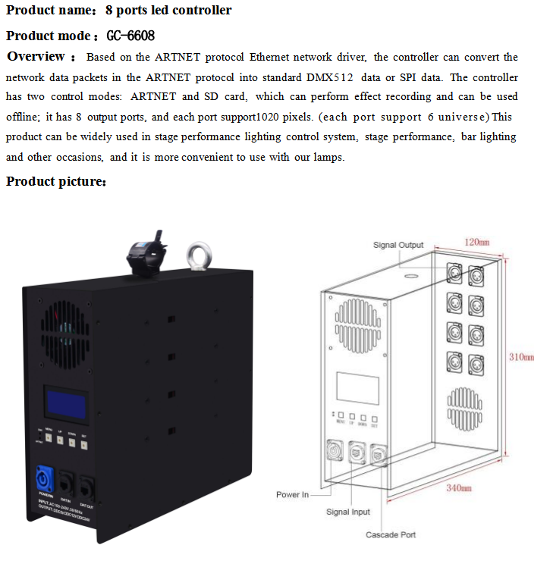
Features of the artnet led controller GC6608
(1). 8 output ports, controls maximum 8160pixels, each port controls maximum 1024 pixels.
(2).Offline SD card, single model controller, with sd card to play the programs inside. with 4GB capacity
(3).GC6612 can be connected to DMX console, you can replace file, and adjust speed and brightness by DMX console.
(4)FPGA, as the core processor, truly realizes high-load, high-speedand high-gray control
(5)suport drawing lighting diagram wireless ( inkbook wifi inside the led controller)
(6)Supports various types of lighting driver ICs: DMX512, UCS series, TM series, LX series, GW series, TLS series, MY series, etc. (7) Support lighting with output Power 1400watt Max with DC 12v and24V optional

Slide 40
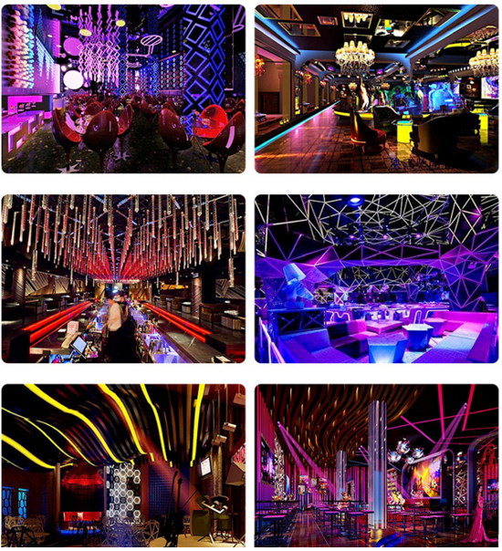

Slide 41
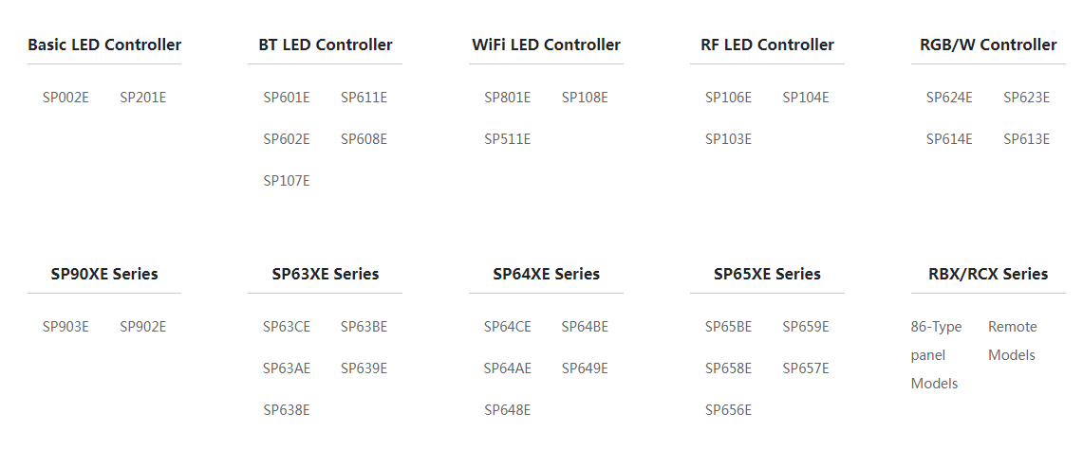
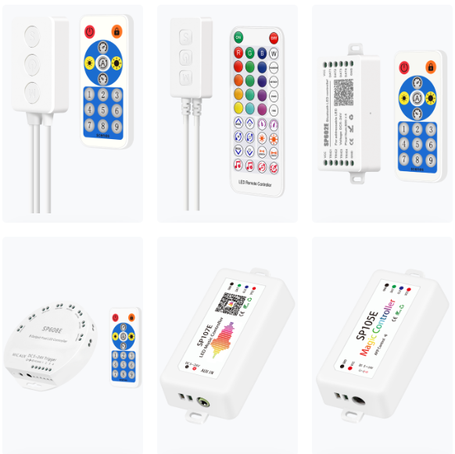
Smart &mini led controller

Slide 42
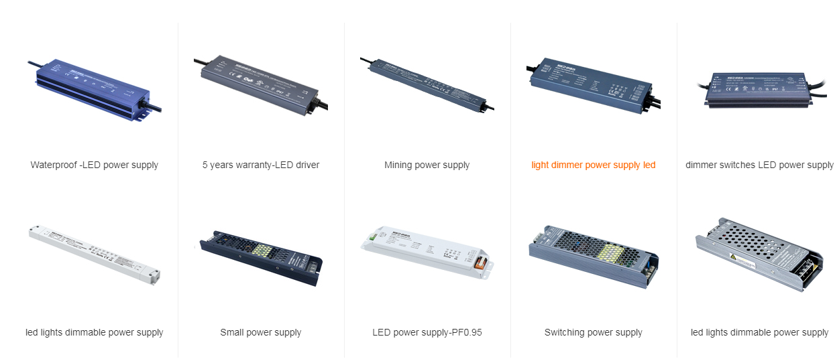
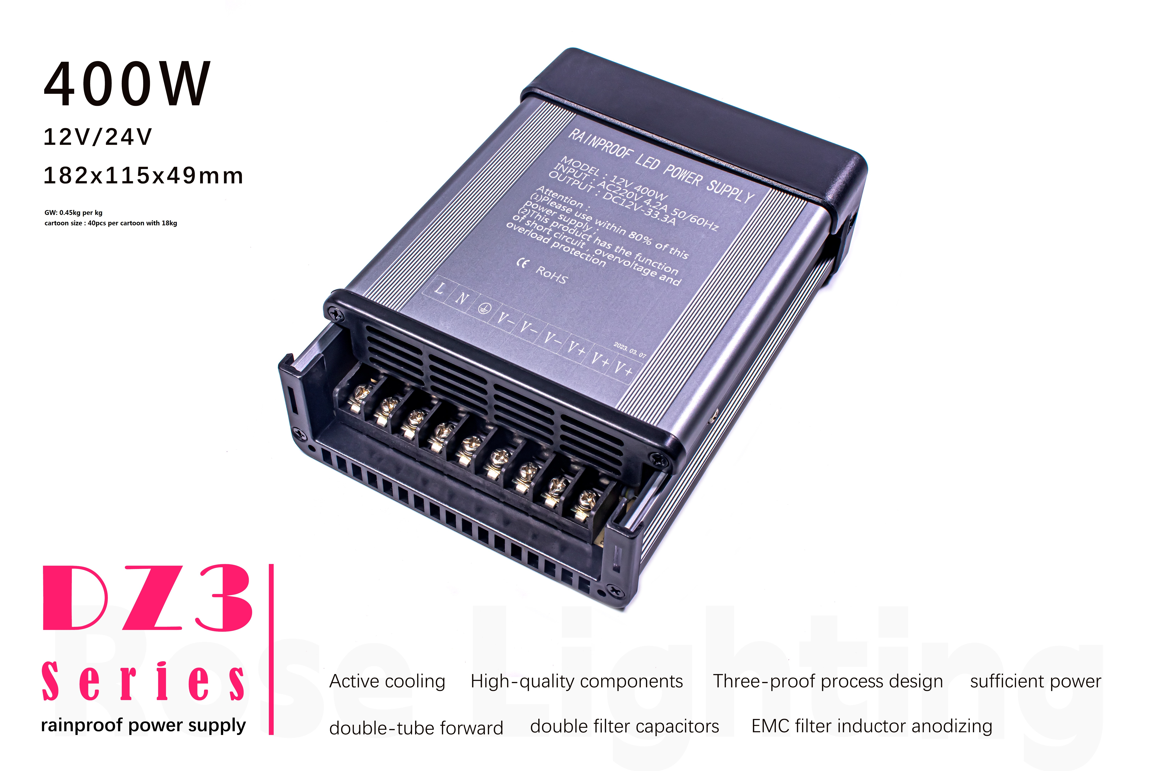
led power supply
we are agent of meanwell led driver

Slide 43
